Slide 1
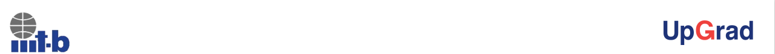
LENDING CLUB CASE STUDY
SUBMISSION
Name : Kalpesh Krushna Zambare.
05/02/2023

Slide 2
Lending Club Loan Assessment for loan default
Lending Club is interested in understanding patterns which indicates if a person is likely to default.
This case study is to process the data set received from the Lending Club data from past loan applicants and identify patterns where the loan is successfully repaid or defaulted.
The assessment helps lending companies to identify risky loan applicants and take early decisions saving credit loss to the company

Slide 3
Exploratory Data Analysis
The data analysis involves below flow for data analysis and problem solving
Load the loan data from lending club
Data Learning
As part of this step carefully understand each columns from the data set, it’s possible impacts
Data Cleaning
Drop the columns from datasets which are all empty, to reduce the size of the data set
Convert the data to lowercase, add numeric columns for the data to extrapolate graphs
Identify and remove outliers(loan_amnt), Impute or Remove rows which are not relevant (current:2% of entire set)

Slide 4
Perform univariate analysis using columns {purpose, term, addr_state, verification_status, sub_grade, emp_length, dti} on loan_status
Note the observations from each of the analysis
Ignore columns which are of not much significance
Plot graphs to understand the behavior
Perform Bivariate anlaysis using columns {(term, purpose),(emp_length, purpose), (sub_grade,emp_length), (term,emp_length)}
Note the observations from each of the analysis
Ignore combinations which are of not much significance, to avoid confusion
Plot graphs to understand the behavior
Plot other graphs and data anslysis as required to get more patterns on the dataset.

Slide 5
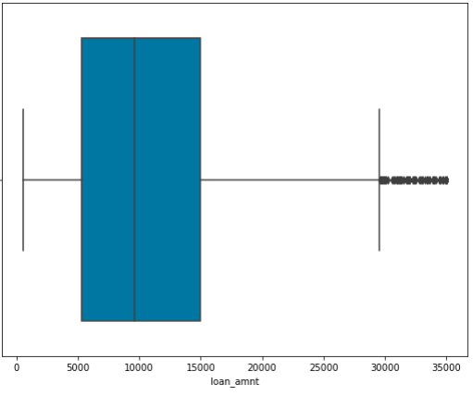

<Anlysis>
As part of initial analysis get the data and cleanup the data sets for processing
Drop rows with loan_status =“current” as it contributes only 2% of the dataset
Remove loan_amnt outliers, as no much relevant data found in analysis form outlier

Slide 6
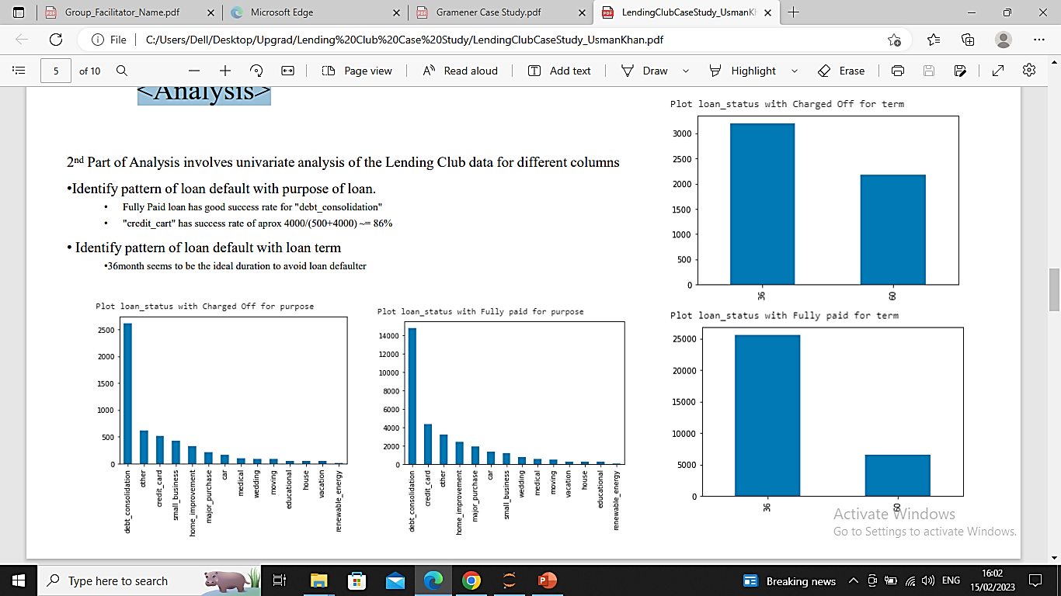
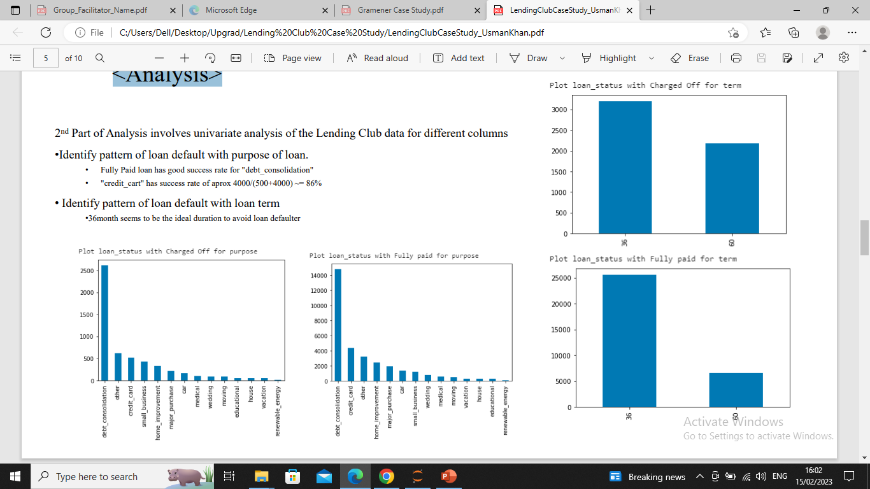
<Anlysis>
2 nd Part of Analysis involves univariate analysis of the
Lending Club data for different columns
Identify pattern of loan default with purpose of loan.
Fully Paid loan has good success rate for "debt_consolidation"
"credit_cart" has success rate of aprox 4000/(500+4000) ~= 86%
Identify pattern of loan default with loan term
36month seems to be the ideal duration to avoid loan defaulte

Slide 7
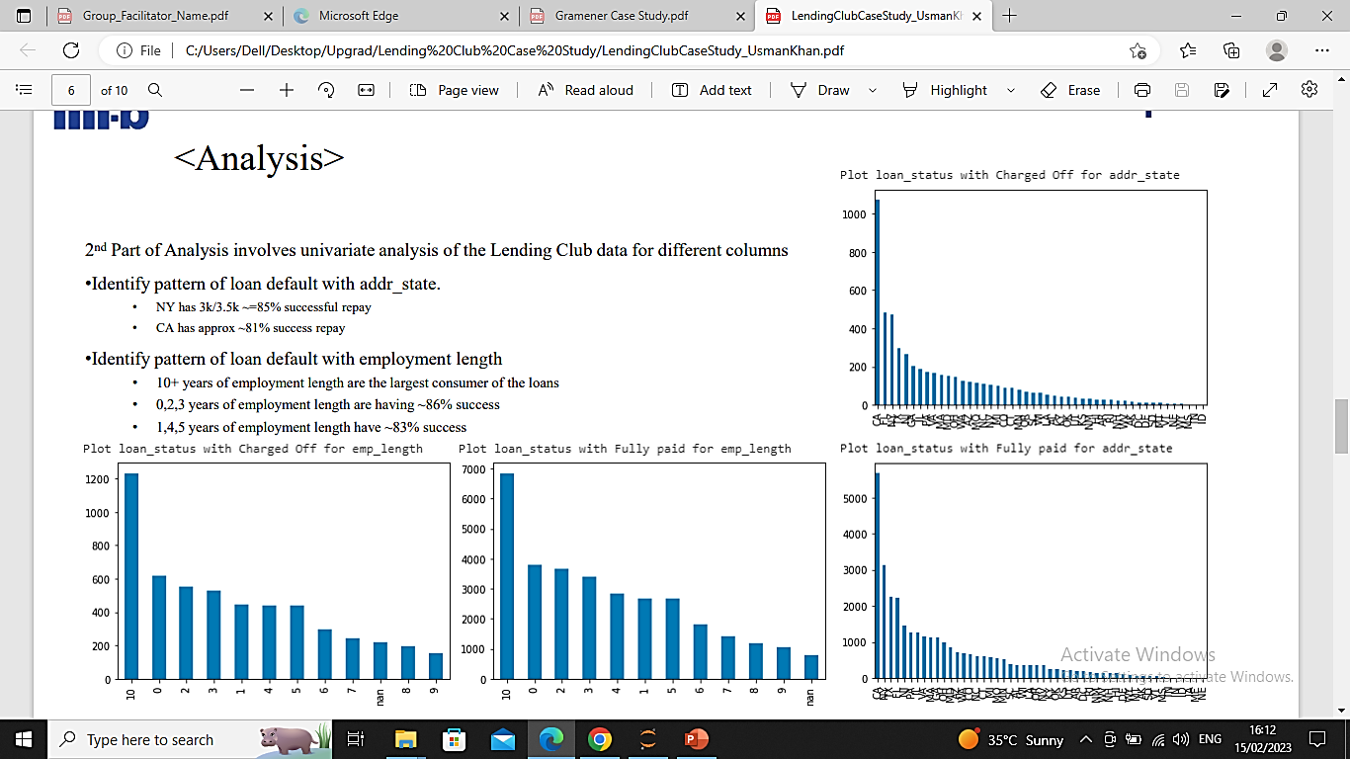
2 nd Part of Analysis involves univariate analysis
of the Lending Club data for different columns
Identify pattern of loan default with addr_state.
NY has 3k/3.5k ~=85% successful repay
CA has approx ~81% success repay
Identify pattern of loan default with employment length
10+ years of employment length are the largest consumer of the loans
0,2,3 years of employment length are having ~86% success
1,4,5 years of employment length have ~83% success

Slide 8
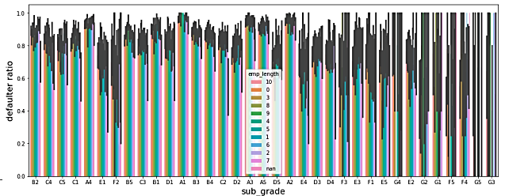

3 rd Part of the Analysis involves bivariate analysis
involving two columns to get the impact on loan status
Employment length and Term has impact on loan status
Not having nay significant impact on term and purpose.
small_business is doing better with 36months term loan
User Grade and employment length has impact on loan status
G grade is not doing well on any emp length

Slide 9
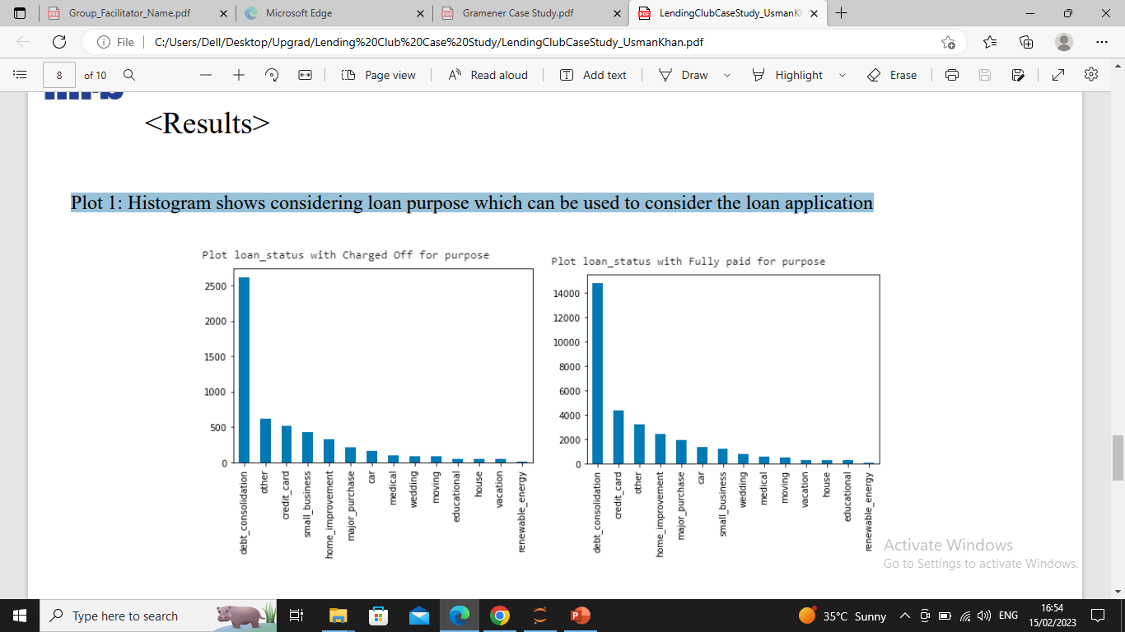
<Results>
Plot 1: Histogram shows considering loan purpose which can be used to consider the loan application

Slide 10
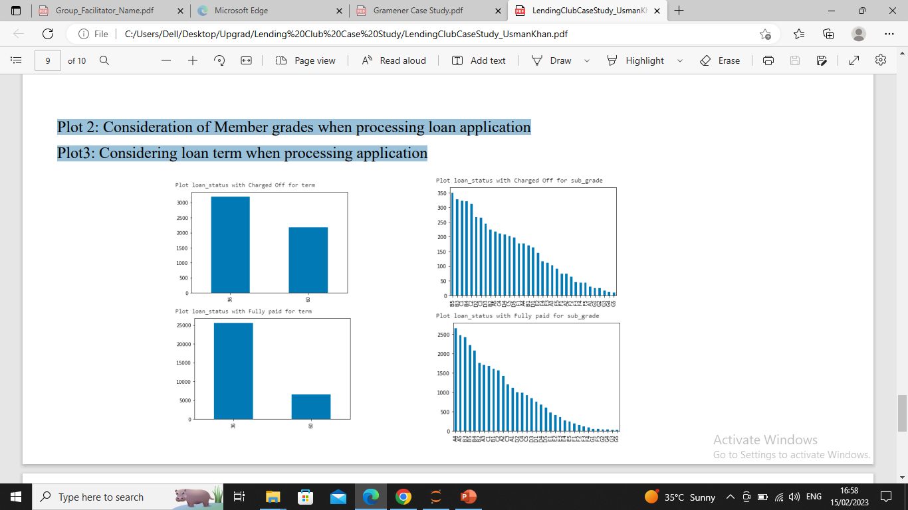
Plot 2: Consideration of Member grades when processing loan application
Plot3: Considering loan term when processing application

Slide 11
<Conclusions>
• Loan Purpose
Fully Paid loan has good success rate for loan purpose for "debt_consolidation“
"credit_card" loan purpose has success rate of aprox 4000/(500+4000) ~= 86%
Loan Duraiton
36month seems to be the ideal duration to avoid loan defaulter
Address State
On the large number of clients as members
NY has 3k/3.5k ~=85% successful repay
CA has approx ~81% success repay
Employment Length has significant impact on loan repayment
10+ years of employment length are the largest consumer of the loans
0,2,3 years of employment length are having ~86% success
1,4,5 years of employment length have ~83% success
Term and Purpose has no significant relation in loan repayment
Not having nay significant impact on term and purpose, except for renewable_energy, educational loan
Purpose and loan duration has impact on the loan repayment
small_business is doing better with 36months term loan
Member grade with employment length has impact on the loan recovery
G grade is not doing well on any emp length

Slide 12
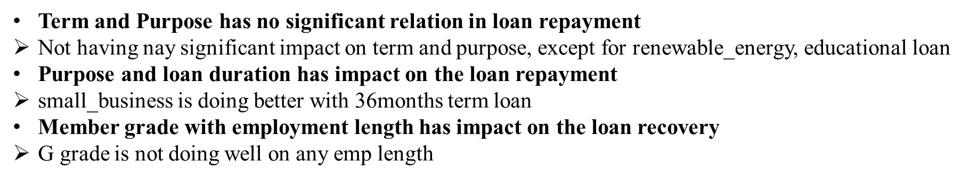
<Conclusions>

